Slide 1
Brand Building on Social Media: A Case Study of Australis Cosmetics’ Facebook Page
by Nikola Kucerova

Slide 2
Overview
Exploratory Analysis
Sentiment Analysis
Prediction of Engagement

Slide 3
Introduction
The aim of the project is to analyse the data set containing Facebook data, interpret the results and provide recommendations.
The data set was acquired using Rfacebook package and it contains information about the posts and comments on Australis Cosmetics Facebook Page.

Slide 4
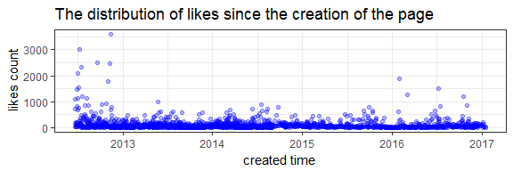
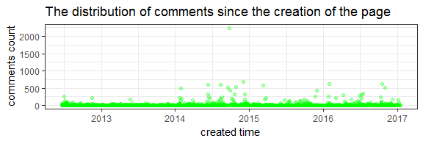
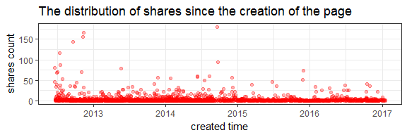
Exploratory Analysis

Slide 5
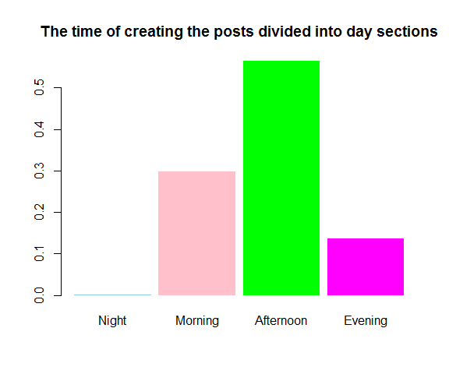
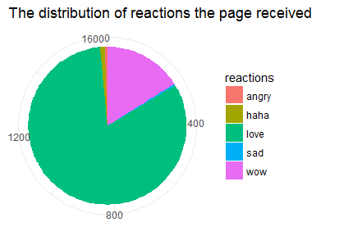
Exploratory Analysis

Slide 6
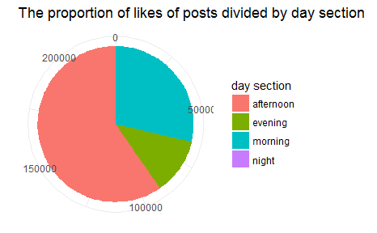
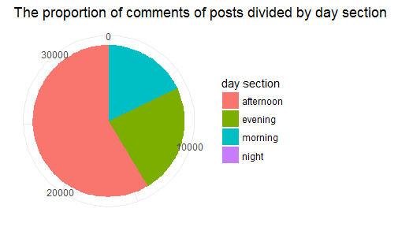
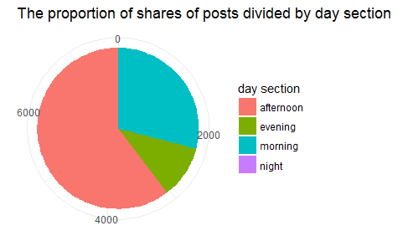
Exploratory Analysis

Slide 7
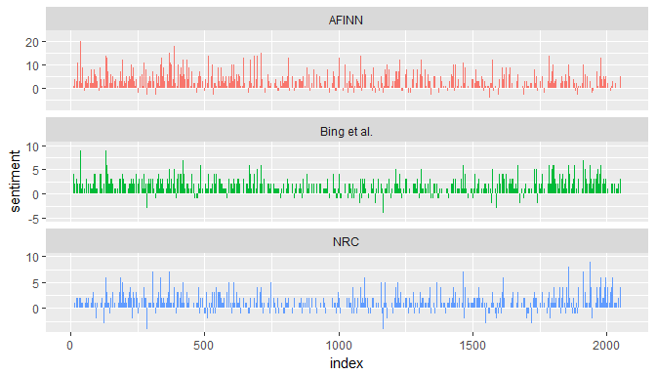
Sentiment Analysis
Tidytext package
Lexicons:
AFINN
bing
nrc
Sentiment of posts:

Slide 8
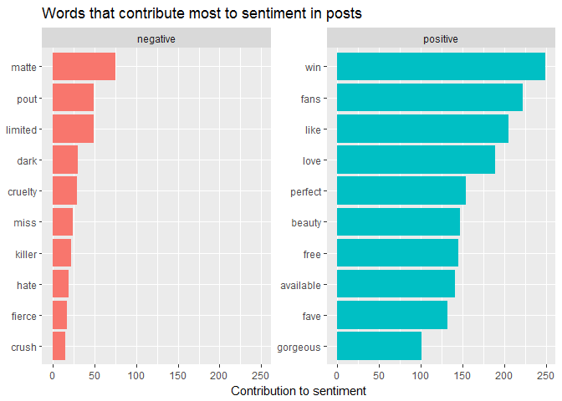
Sentiment Analysis

Slide 9
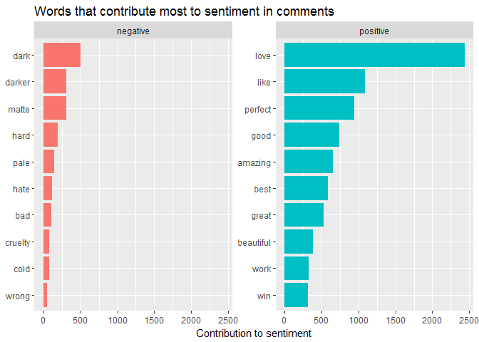
Sentiment Analysis

Slide 10
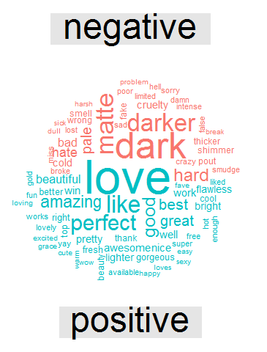
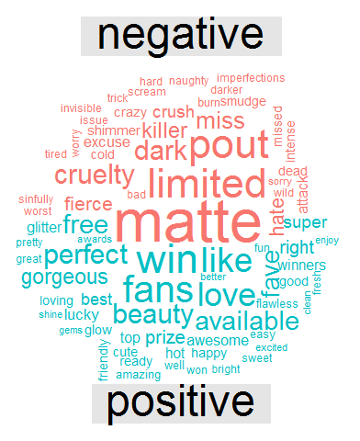
Sentiment Analysis - Word clouds for comments and posts

Slide 11
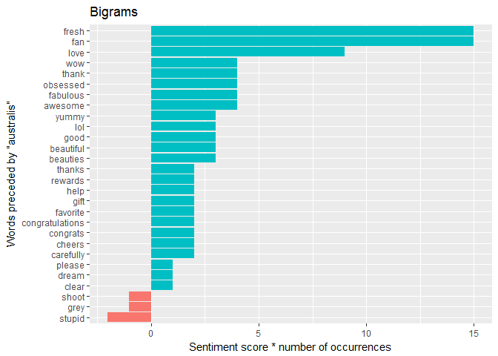
Sentiment Analysis

Slide 12
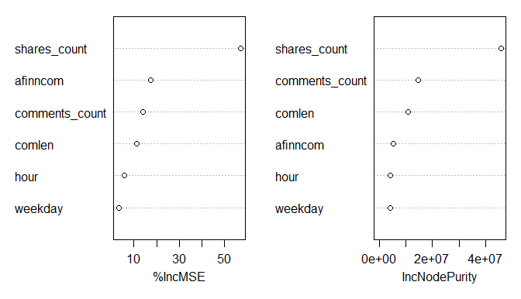
Prediction of Engagement
randonForest package - regression model
randomForest(likes_count ~ comments_count + shares_count + comlen + afinncom + weekday + hour
The highest achieved value of explained variance was 46.74%.

Slide 13
Recommendations
Even though sentiment in the comments is generally very positive, it might be worth examining the comments with negative feedback more closely in order to provide better customer service.
Based on exploratory analysis, if the company decides to post a post where it asks users for feedback in the comments section, it might be useful to take into account the time of the day and the day of the week when users are more likely to respond.
In sentiment analysis, some comments received much higher positive score than others. These posts should also be examined more closely to reveal what evokes such a positive reaction. This finding can be helpful when creating other posts.

